Slide 1


Exposure Java 2015
AP®CS Edition
Chapter 9 Slides
Focus on OOP: Encapsulation
PowerPoint Presentation
created by:
Mr. John L. M. Schram
and Mr. Leon Schram
Authors of Exposure Java

Slide 2
Section 9.1
Introduction

Slide 3
Objects, Variables & Methods
Java encapsulates data and action modules that access the data in one container, called an object.
Object members that perform some task are called methods.
Object members that store data are called attributes.

Slide 4
Section 9.2
Creating a
New Class

Slide 5

The Card Case Study
Card Methods | Card Attributes
getSuit | suit Spades, Hearts, Diamonds & Clubs
getRank | rank Two, Three…Ten, Jack, Queen, King, Ace
getPointValue | pointValue Different values for different games…
Poker
2…10 | 2…10
Jack | 11
Queen | 12
King | 13
Ace | 14
Black Jack
2…10 | 2…10
Jack | 10
Queen | 10
King | 10
Ace | 11, 1
Sumba Canasta
2 | 20
3…7 | 5
8…King | 10
Ace | 20
Joker | 50

Slide 6
// Java0901.java
// Card Case Study #01
// This shows a minimal class declaration.
// This class has no practical value, but it compiles and executes.
public class Java0901
{
public static void main(String args[])
{
System.out.println("JAVA0901.JAVA");
System.out.println();
Card card = new Card();
}
}
class Card
{
}
Java0901.JAVA

Slide 7
Section 9.3
Restricting
Attribute Access

Slide 8

// Java0902.java
// Card Case Study #02
// Data fields, called attributes or instance variables,
// are added to the <Card> class.
public class Java0902
{
public static void main(String args[])
{
System.out.println("JAVA0902.JAVA");
System.out.println();
Card card = new Card();
}
}
class Card
{
String suit; // Clubs, Diamonds, Hearts, Spades
String rank; // Number, Jack, Queen, King, Ace
int pointValue; // Number, 10 for picture, 11 for Ace
}
Java0902.JAVA

Slide 9

// Java0903.java
// Card Case Study #03
// <Card> attributes are accessed directly by the <main> method.
// This program violates encapsulation, even though it compiles, and executes.
// This approach greatly compromises program reliability.
public class Java0903
{
public static void main(String args[])
{
System.out.println("JAVA0903.JAVA");
System.out.println();
Card card = new Card();
card.suit = "Hearts";
card.rank = "King";
card.pointValue = 10;
System.out.println("Suit: " + card.suit);
System.out.println("Rank: " + card.rank);
System.out.println("Value: " + card.pointValue);
}
}
JAVA0903.JAVA
Suit: Hearts
Rank: King
Value: 10
class Card
{
String suit;
String rank;
int pointValue;
}

Slide 10
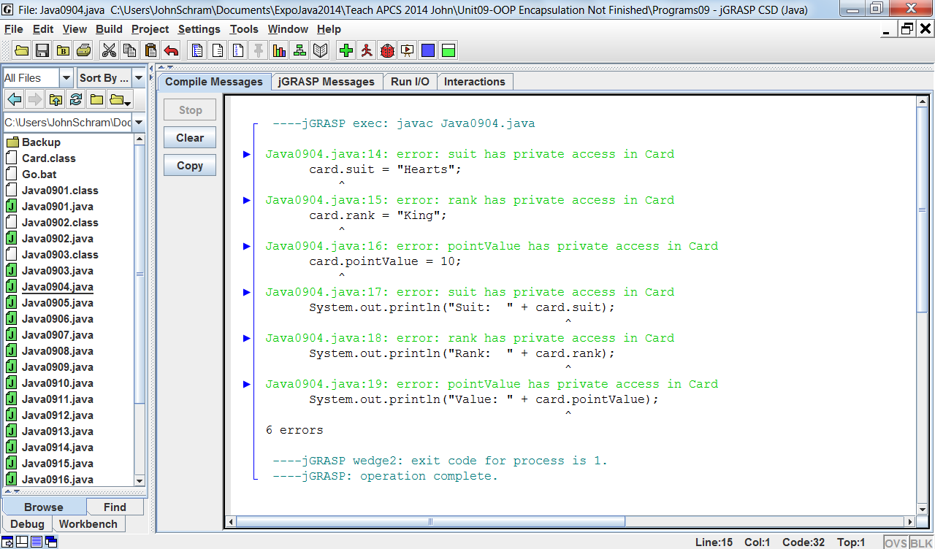

// Java0904.java
// Card Case Study #04
// All the variables in the <Card> class
// are now declared as private access.
// This prevents improper, public access
// to the data variables.
public class Java0904
{
public static void main(String args[])
{
System.out.println("JAVA0904.JAVA");
System.out.println();
Card card = new Card();
card.suit = "Hearts";
card.rank = "King";
card.pointValue = 10;
System.out.println("Suit: " + card.suit);
System.out.println("Rank: " + card.rank);
System.out.println("Value: " + card.pointValue);
}
}
class Card
{
private String suit;
private String rank;
private int pointValue;
}

Slide 11
private & public Members
Members in a class need to be declared as private or public.
private members cannot be accessed by any program segments outside the class.
Data attributes of a class usually need to be declared private.
public members of a class can be accessed by program segments outside the class.

Slide 12
“Mr. Schram, how does using private give you any security when you can just change it back to public?”
Think of any video game that you
have ever purchased.
Do you ever see the source code?
Only the programmers have the source code.
What they sell to users is an executable file.

Slide 13
Section 9.4
Get & Set
Methods

Slide 14
// Java0905.java
// Card Case Study #05
// The <Card> class now has three methods to return
// the data values of <Card> class objects.
// Note that Java assigns initial values to object data.
public class Java0905
{
public static void main(String args[])
{
System.out.println("JAVA0905.JAVA");
System.out.println();
Card card = new Card();
System.out.println("Suit: " + card.suit());
System.out.println("Rank: " + card.rank());
System.out.println("Value: " + card.pointValue());
}
}
JAVA0905.JAVA
Suit: null
Rank: null
Value: 0

Slide 15
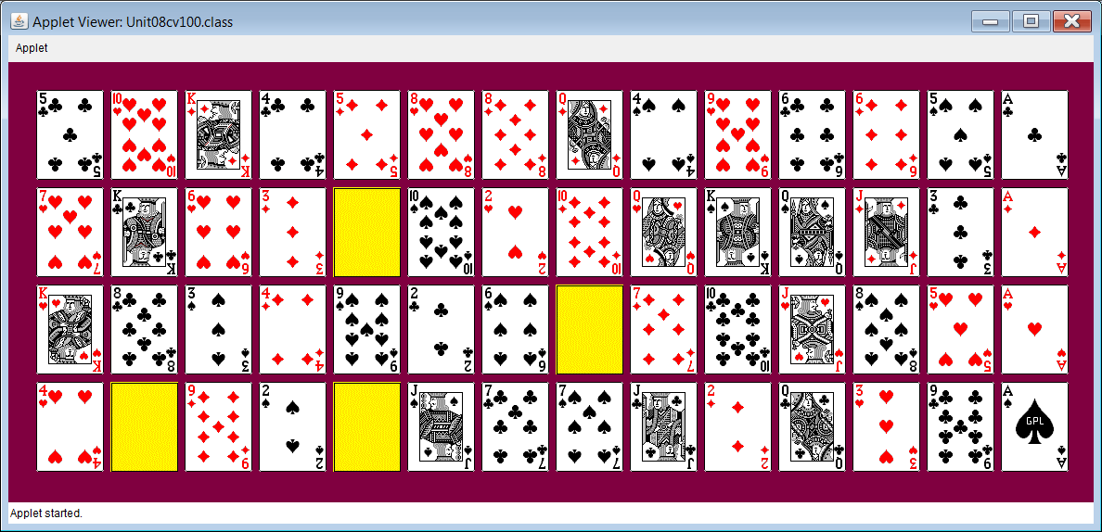
class Card
{
private String suit;
private String rank;
private int pointValue;
public String suit() { return suit; }
public String rank() { return rank; }
public int pointValue() { return pointValue; }
}

Slide 16
// Java0906.java
// Card Case Study #06
// This program is identical to Java0905.java.
// The names of the return methods are changed.
// It is a common convention to call methods that
// return attribute values "get" methods.
public class Java0906
{
public static void main(String args[])
{
System.out.println("JAVA0906.JAVA");
System.out.println();
Card card = new Card();
System.out.println("Suit: " + card.getSuit());
System.out.println("Rank: " + card.getRank());
System.out.println("Value: " + card.getPointValue());
}
}

Slide 17
class Card
{
private String suit;
private String rank;
private int pointValue;
public String getSuit() { return suit; }
public String getRank() { return rank; }
public int getPointValue() { return pointValue; }
}

Slide 18
// Java0907.java
// Card Case Study #07
// The <Card> class adds three "set" methods to
// alter the data attributes of <Card> objects.
public class Java0907
{
public static void main(String args[])
{
System.out.println("JAVA0907.JAVA");
System.out.println();
Card card = new Card();
card.setSuit("Clubs");
card.setRank("Seven");
card.setPointValue(7);
System.out.println("Suit: " + card.getSuit());
System.out.println("Rank: " + card.getRank());
System.out.println("Value: " + card.getPointValue());
}
}

Slide 19
class Card
{
private String suit;
private String rank;
private int pointValue;
public String getSuit() { return suit; }
public String getRank() { return rank; }
public int getPointValue() { return pointValue; }
public void setSuit(String s) { suit = s; }
public void setRank(String r) { rank = r; }
public void setPointValue(int pV) { pointValue = pV; }
}

Slide 20
Section 9.5
Constructor
Methods

Slide 21
// Java0908.java
// Card Case Study #08
// This <Card> class uses a constructor to initialize variables
// during the instantiation of a new <Card> object.
// This is an example of increasing reliability by an automatic
// constructor call.
public class Java0908
{
public static void main(String args[])
{
System.out.println("JAVA0908.JAVA");
System.out.println();
Card card = new Card();
System.out.println("Suit: " + card.getSuit());
System.out.println("Rank: " + card.getRank());
System.out.println("Value: " + card.getPointValue());
}
}

Slide 22

class Card
{
private String suit;
private String rank;
private int pointValue;
public Card()
{
suit = "Clubs";
rank = "Two";
pointValue = 2;
}
public String getSuit() { return suit; }
public String getRank() { return rank; }
public int getPointValue() { return pointValue; }
}

Slide 23
// Java0909.java
// Card Case Study #09
// A second, overloaded constructor, method is added to the program.
// It is now possible to specify Card object details during instantiation.
public class Java0909
{
public static void main(String args[])
{
System.out.println("JAVA0909.JAVA");
System.out.println();
Card card = new Card("Diamonds","Queen",10);
System.out.println("Suit: " + card.getSuit());
System.out.println("Rank: " + card.getRank());
System.out.println("Value: " + card.getPointValue());
}
}

Slide 24
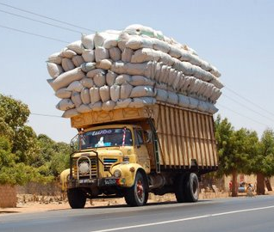
class Card
{
private String suit;
private String rank;
private int pointValue;
public Card()
{
suit = "Clubs";
rank = "Two";
pointValue = 2;
}
public Card(String s, String r, int pV)
{
suit = s;
rank = r;
pointValue = pV;
}
public String getSuit() { return suit; }
public String getRank() { return rank; }
public int getPointValue() { return pointValue; }
}

Slide 25

Instantiation & Construction
A class is a template that can form many objects.
An object is a single variable instance of a class.
Objects are sometimes called instances.
An object is created with the new operator.
The creation of a new object is called:
instantiation of an object
construction of an object
The special method that is called during the instantiation of a new object is the constructor.

Slide 26





Constructor Notes
Constructors are methods, which are called during the
instantiation of an object with the new operator.
The primary purpose of a constructor is to
initialize all the attributes of newly created object.
Constructors have the same identifier as the class.
Constructors are neither void methods nor are they
return methods. They are simply constructors.
Constructors are always declared public.
Constructors can be overloaded methods.
The method identifier can be the same, but the method
signature (which is the parameter list) must be different.
A constructor with no parameters
is called a default constructor.

Slide 27
Section 9.6
The Cube
Case Study

Slide 28

The Cube Case Study
Cube Methods | Cube Data
Draw Cube | x Coordinate
Erase Cube | y Coordinate
Move Cube | size

Slide 29

// Java0910.java
// Cube Case Study #1
// Stage #1 presents a <Cube> class with a default constructor.
// This program does not display a cube.
// The Cube Case Study uses applets. Run the html file to execute.
public class Java0910 extends Applet
{
public void paint(Graphics g)
{
Cube cube = new Cube(g);
}
}
class Cube
{
private int tlX; // topleft X coordinate of the Cube's position
private int tlY; // topleft y coordinate of the Cube's position
public Cube(Graphics g)
{
tlX = 50;
tlY = 50;
}
}

Slide 30
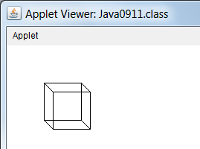

// Java0911.java Cube Case Study #2
// Stage #2 presents adds a <draw> method to display one cube object.
public class Java0911 extends Applet
{
public void paint(Graphics g)
{
Cube cube = new Cube(g);
cube.draw(g);
}
}
class Cube
{
private int tlX; // topleft X coordinate of the Cube's position
private int tlY; // topleft y coordinate of the Cube's position
public Cube(Graphics g) { tlX = 50; tlY = 50; }
public void draw(Graphics g)
{
int tlX2 = tlX + 12;
int tlY2 = tlY + 12;
g.setColor(Color.black);
g.drawRect(tlX,tlY,50,50);
g.drawRect(tlX2,tlY2,50,50);
g.drawLine(tlX,tlY,tlX2,tlY2);
g.drawLine(tlX+50,tlY,tlX2+50,tlY2);
g.drawLine(tlX,tlY+50,tlX2,tlY2+50);
g.drawLine(tlX+50,tlY+50,tlX2+50,tlY2+50);
}
}

Slide 31
// Java0912.java Cube Case Study #3 // Stage #3 adds a second, overloaded constructor. // It is now possible to specify the size and the location of the cube. // The <draw> method needs to be altered to handle different cube sizes.
import java.awt.*; import java.applet.*; public class Java0912 extends Applet { public void paint(Graphics g) { Cube cube1 = new Cube(g,50,50,50); cube1.draw(g); Cube cube2 = new Cube(g,400,50,100); cube2.draw(g); Cube cube3 = new Cube(g,50,300,150); cube3.draw(g); Cube cube4 = new Cube(g,400,300,200); cube4.draw(g); } } class Cube { private int tlX; private int tlY; private int size; | public Cube(Graphics g) { tlX = 50; tlY = 50; size = 50; } public Cube(Graphics g, int x, int y, int s) { tlX = x; tlY = y; size = s; } public void draw(Graphics g) { int tlX2 = tlX + size/3; int tlY2 = tlY + size/3; g.setColor(Color.black); g.drawRect(tlX,tlY,size,size); g.drawRect(tlX2,tlY2,size,size); g.drawLine(tlX,tlY,tlX2,tlY2); g.drawLine(tlX+size,tlY,tlX2+size,tlY2); g.drawLine(tlX,tlY+size,tlX2,tlY2+size); g.drawLine(tlX+size,tlY+size,tlX2+size,tlY2+size); } }

Slide 32
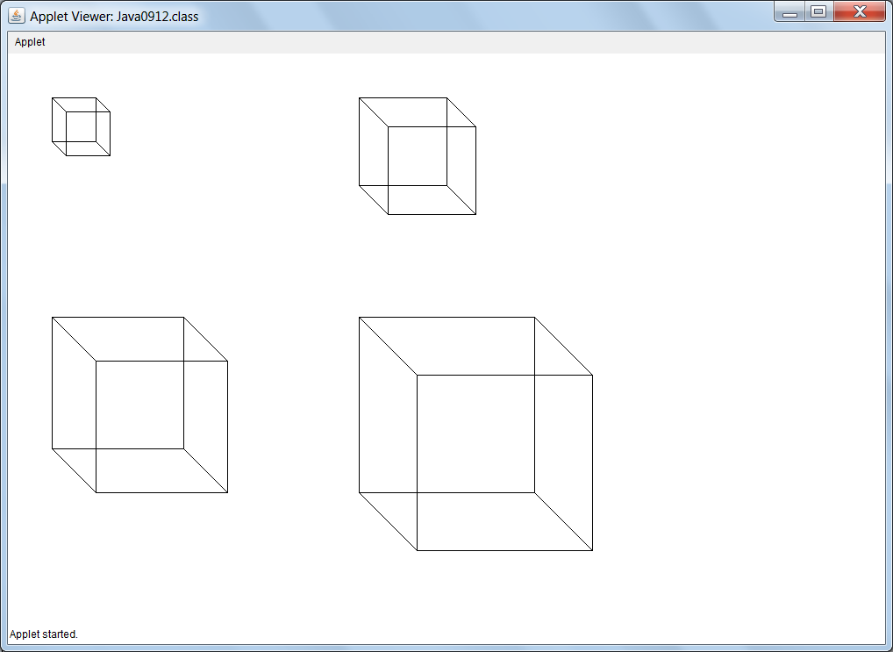

Slide 33
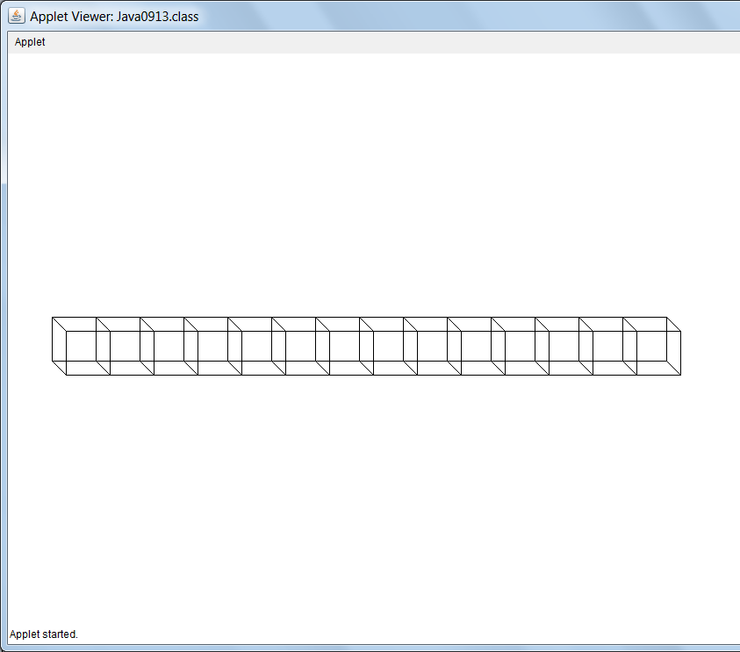

// Java0913.java Cube Case Study #4
// Stage #4 adds a <move> method, which updates the cube's coordinates
// and draws a cube at the new location.
// Only new methods are shown.
public class Java0913 extends Applet
{
public void paint(Graphics g)
{
Cube cube = new Cube(g,50,50,50);
for (int x = 50; x < 750; x += 50)
cube.move(g,x,300);
}
}
class Cube
{
private int tlX; // topleft X coordinate of the Cube's position
private int tlY; // topleft y coordinate of the Cube's position
private int size; // the size of the cube along one edge
public void move(Graphics g, int x, int y)
{
tlX = x; tlY = y; draw(g);
}
}

Slide 34
// Java0914.java Cube Case Study #5 // Stage #5 adds an <erase> method, which erases the cube at the current [tlX,tlY] coordinates. // This program has a problem because the cube object is erased immediately after it is drawn.
import java.awt.*; import java.applet.*; public class Java0914 extends Applet { public void paint(Graphics g) { Cube cube = new Cube(g,50,50,50); for (int x = 50; x < 750; x += 50) { cube.move(g,x,300); cube.erase(g); } } } | class Cube { private int tlX; // topleft X coordinate of the Cube's position private int tlY; // topleft y coordinate of the Cube's position private int size; // the size of the cube along one edge public void erase(Graphics g) { int tlX2 = tlX + size/3; int tlY2 = tlY + size/3; g.setColor(Color.white); g.drawRect(tlX,tlY,size,size); g.drawRect(tlX2,tlY2,size,size); g.drawLine(tlX,tlY,tlX2,tlY2); g.drawLine(tlX+size,tlY,tlX2+size,tlY2); g.drawLine(tlX,tlY+size,tlX2,tlY2+size); g.drawLine(tlX+size,tlY+size,tlX2+size,tlY2+size); } }

Slide 35

It seems like there is no output.
The problem is the output is
so fast you cannot see it.

Slide 36
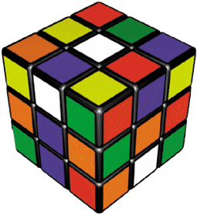
// Java0915.java Cube Case Study #6 // Stage #6 adds a <delay> method which stops program execution for a specified number of // milli seconds. This makes the cube visible and creates a simple type of animation.
import java.awt.*; import java.applet.*; public class Java0915 extends Applet { public void paint(Graphics g) { Cube cube = new Cube(g,50,50,50); for (int x = 50; x < 750; x += 50) { cube.move(g,x,300); cube.delay(100); cube.erase(g); } } } | class Cube { private int tlX; // topleft X coordinate of the Cube's position private int tlY; // topleft y coordinate of the Cube's position private int size; // the size of the cube along one edge public void delay(int n) { long startDelay = System.currentTimeMillis(); long endDelay = 0; while (endDelay - startDelay < n) endDelay = System.currentTimeMillis(); } }

Slide 37

Note: Output simulated
with PowerPoint
Try This:
For smoother output
change the delay to 10
and the x+=20 to x+=2.

Slide 38
// Java0916.java Cube Case Study #7 // Stage #7 adds three methods that return the values of instance variables. // They are methods <getX>, <getY> and <getSize>.
import java.awt.*; import java.applet.*; public class Java0916 extends Applet { public void paint(Graphics g) { Cube cube = new Cube(g,50,50,50); Cube cube = new Cube(g,400,300,200); cube.draw(g); System.out.println("Top Left X: " + cube.getX()); System.out.println("Top Left Y: " + cube.getY()); System.out.println("Cube Size: " + cube.getSize()); } | class Cube { private int tlX; // topleft X coordinate of the Cube's position private int tlY; // topleft y coordinate of the Cube's position private int size; // the size of the cube along one edge public int getX() { return tlX; } public int getY() { return tlY; } public int getSize() { return size; } }
Outputs shown on the next 3 slides.

Slide 39
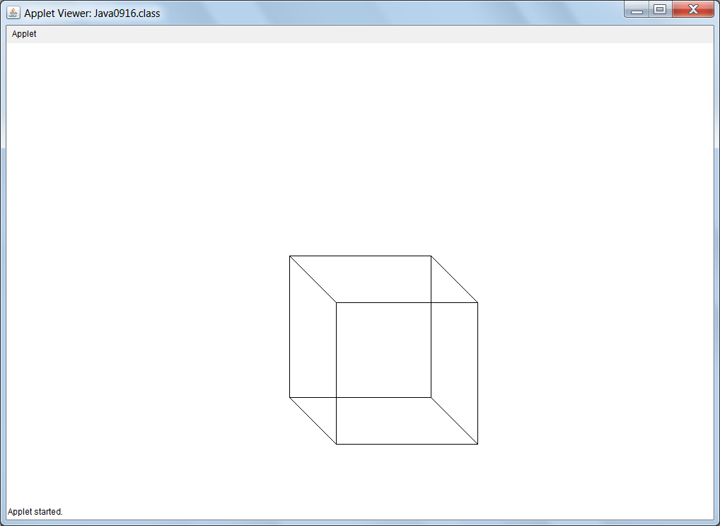
GUI Output of
Program Java0916.java

Slide 40
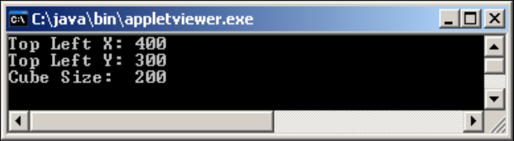
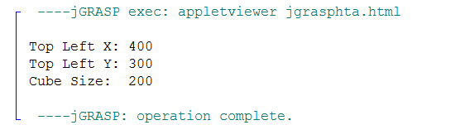
Located behind the GUI window
Possible Text Outputs of
Program Java0916.java
Located at the bottom of jGRASP

Slide 41
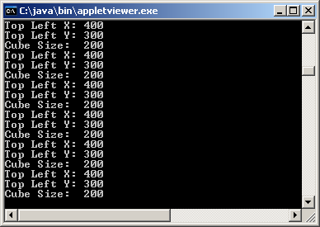
Weird Output!
You might get this output when switching between the GUI and Text windows.
This happens if you drag something in front of the GUI window or resize it.
The GUI window will need to be refreshed which will cause the paint method to be called repeatedly.

Slide 42
Section 9.7
The Consequences
of Scope

Slide 43
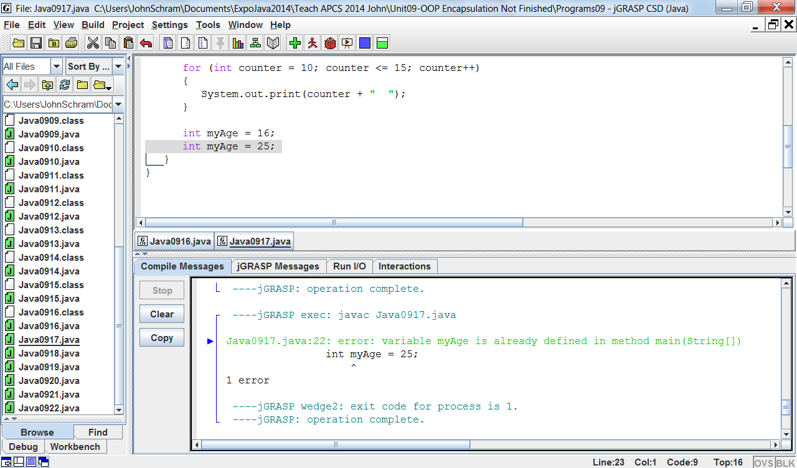
// Java0917.java
// This program demonstrates how one variable name <counter>
// can be declared twice correctly.
// It also shows <myAge> declared twice incorrectly.
public class Java0917
{
public static void main(String args[])
{
for (int counter = 1; counter <= 5; counter++)
System.out.print(counter + " ");
for (int counter = 10; counter <= 15; counter++)
System.out.print(counter + " ");
int myAge = 16;
int myAge = 25;
}
}

Slide 44
// Java0918.java
// This program demonstrates the scope of a variable.
public class Java0918
{
public static void main(String args[])
{
int var1 = 10;
System.out.println("var1 in main is " + var1);
System.out.print("var2 inside the main method for loop is ");
for (int var2 = 1; var2 < 10; var2++)
{
System.out.print(var2 + " ");
}
System.out.println();
Boo boo = new Boo(var1);
System.out.println("var4 in Boo is " + boo.getData());
System.out.println();
}
}

Slide 45
class Boo
{
private int var4;
public Boo(int var3)
{
var4 = var3;
System.out.println("var3 in constructor is " + var3);
}
public int getData()
{
return var4;
}
}
var1 in main is 10
var2 inside the main method for loop is 1 2 3 4 5 6 7 8 9
var3 in constructor is 10
var4 in Boo is 10

Slide 46
// Java0918.java
// This program demonstrates the scope of a variable.
public class Java0918
{
public static void main(String args[])
{
int var1 = 10;
System.out.println("var1 in main is " + var1);
System.out.print("var2 inside the main method for loop is ");
for (int var2 = 1; var2 < 10; var2++)
{
System.out.print(var2 + " ");
}
System.out.println();
Boo boo = new Boo(var1);
System.out.println("var4 in Boo is " + boo.getData());
System.out.println();
}
}
Scope of var1

Slide 47
// Java0918.java
// This program demonstrates the scope of a variable.
public class Java0918
{
public static void main(String args[])
{
int var1 = 10;
System.out.println("var1 in main is " + var1);
System.out.print("var2 inside the main method for loop is ");
for (int var2 = 1; var2 < 10; var2++)
{
System.out.print(var2 + " ");
}
System.out.println();
Boo boo = new Boo(var1);
System.out.println("var4 in Boo is " + boo.getData());
System.out.println();
}
}
Scope of var2

Slide 48
class Boo
{
private int var4;
public Boo(int var3)
{
var4 = var3;
System.out.println("var3 in constructor is " + var3);
}
public int getData()
{
return var4;
}
}
Scope of var3

Slide 49
class Boo
{
private int var4;
public Boo(int var3)
{
var4 = var3;
System.out.println("var3 in constructor is " + var3);
}
public int getData()
{
return var4;
}
}
Scope of var4

Slide 50
Scope Definition
What is scope? The scope of a variable - simple, primitive data type or complex object - is the segment of a program during which a variable is defined, has allocated memory to store values and can be accessed.
If two variables have the same identifier and also the same scope, Java will object with a duplicate definition compile error.

Slide 51
// Java0919.java
// This program shows the logic problem that results from using two variables
// with the same name identifier, but two different scopes.
public class Java0919
{
public static void main(String args[])
{
Widget w = new Widget(100);
System.out.println("Object w has " + w.getWidgets() + " widgets");
}
}
class Widget
{
private int numWidgets;
public Widget(int numWidgets)
{
numWidgets = numWidgets;
}
public int getWidgets()
{
return numWidgets;
}
}
Object w has 0 widgets

Slide 52
// Java0920.java
// Using different variable names is one solution to the
// problem caused by program Java0919.java.
public class Java0920
{
public static void main(String args[])
{
Widget w = new Widget(100);
System.out.println("Object w has " + w.getWidgets() + " widgets");
}
}
class Widget
{
private int numWidgets;
public Widget(int nW)
{
numWidgets = nW;
}
public int getWidgets()
{
return numWidgets;
}
}
Object w has 100 widgets

Slide 53
// Java0921.java
// Using the <this> reference is a second solution to the
// problem in program Java0919.java.
public class Java0921
{
public static void main(String args[])
{
Widget w = new Widget(100);
System.out.println("Object w has " + w.getWidgets() + " widgets");
}
}
class Widget
{
private int numWidgets;
public Widget(int numWidgets)
{
this.numWidgets = numWidgets; // required use of this
}
public int getWidgets()
{
return this.numWidgets; // optional use of this
}
}
Object w has 100 widgets

Slide 54
// Java0922.java
// Comparing the value of the three <Widget> objects demonstrates
// that the <this> reference value is equal to the current object used.
public class Java0922
{
public static void main(String args[])
{
Widget w1 = new Widget(100);
System.out.println("w1 value: " + w1);
System.out.println();
Widget w2 = new Widget(100);
System.out.println("w2 value: " + w2);
System.out.println();
Widget w3 = new Widget(100);
System.out.println("w3 value: " + w3);
System.out.println();
}
}
this value: Widget@1db9742
w1 value: Widget@1db9742
this value: Widget@106d69c
w2 value: Widget@106d69c
this value: Widget@52e922
w3 value: Widget@52e922
class Widget
{
private int numWidgets;
public Widget(int numWidgets)
{
this.numWidgets = numWidgets;
System.out.println("this value: " + this);
}
}

Slide 55
Section 9.8
Method
Summary

Slide 56
Class or Static Methods
Class methods are sometimes called static methods because they have the keyword static in their heading.
A class method is called with the class identifier, not with an object of the class.
This is practical when there is no need to make multiple objects of a class.
A good example is Java’s Math class.

Slide 57
Class or Static Methods
public class Demo
{
public static void main(String args[])
{
Piggy.initData();
Piggy.showData();
Piggy.addData(1200);
Piggy.showData();
}
}
class Piggy
{
public static double savings;
public static void initData() { savings = 0; }
public static void addData(double s) { savings += s; }
public static void showData() { System.out.println("Savings: " + savings); }
}

Slide 58
Object or Non-Static Methods
Object methods are sometimes called non-static methods because they do NOT have the keyword static in their heading.
Object methods are meant for those situations where multiple objects of a class must be constructed.
An object must be constructed first with the new operator, and then object methods are called by using the object identifier.

Slide 59

Object or Non-Static Methods
public class Demo
{
public static void main(String args[])
{
Piggy tom = new Piggy();
tom.initData();
tom.showData();
tom.addData(1200);
tom.showData();
}
}
class Piggy
{
private double savings;
public void initData() { savings = 0; }
public void addData(double s) { savings += s; }
public void showData() { System.out.println("Savings: " + savings); }
}

Slide 60

Public Methods
Essentially, public methods
can be accessed anywhere.
The majority of methods are public.
public int getCards()
{
return cardsLeft;
}

Slide 61

Private or Helper Methods
Occasionally, a method is created in a class that is never called outside of the class.
In such a case, the method
should be declared private.
These private methods are sometimes called helper methods because they help and support the other methods of the class.

Slide 62
Void Methods
Void methods do NOT return a value and use the reserved word void to indicate that no value will be returned.
public void showData()
{
System.out.println("Name: " + name);
System.out.println("Savings: " + savings);
}

Slide 63
Return Methods
Return methods are methods that return a value.
Two features are necessary for a return method:
First, you will see that the method heading indicates a data type, which is the type that the method returns.
Second, you see a return statement at the end of the method body.
public double getSavings()
{
return savings;
}

Slide 64

Default Constructor Methods
A constructor is a special method that is automatically called during the instantiation
of a new object.
If no visible constructor is provided, Java will provide its own constructor, called a
default constructor.
Additionally, we also call a
no-parameter constructor
a default constructor.
public Card()
{
suit = "Clubs";
rank = "Two";
pointValue = 2;
}

Slide 65




Overloaded Constructor Methods
An overloaded constructor is a second, third or more, constructor that allows a new object to be instantiated according to some specifications that are passed by parameters.
public Card(String s, String r, int pV)
{
suit = s;
rank = r;
pointValue = pV;
}

Slide 66
Accessing or Get Methods
Methods that only access object data without altering the data are called accessing or get methods.
Most accessing methods are return methods, which return object private data information.
public int getDecks()
{
return numDecks;
}

Slide 67

Altering or Modifier or Mutator or Set Methods
These are methods that not only access the private data of an object; they also alter the value of the data.
public void savingsDeposit(double s)
{
savings += s;
}

